Slide 1


Rest Assured API Automation
Day 6 - Advance Topics

Slide 2
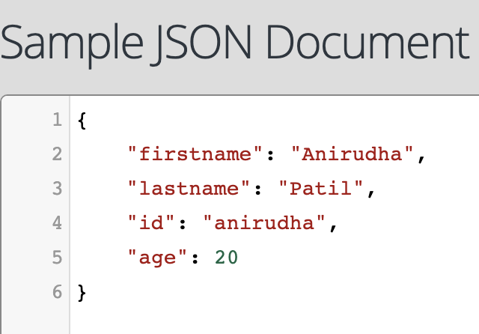
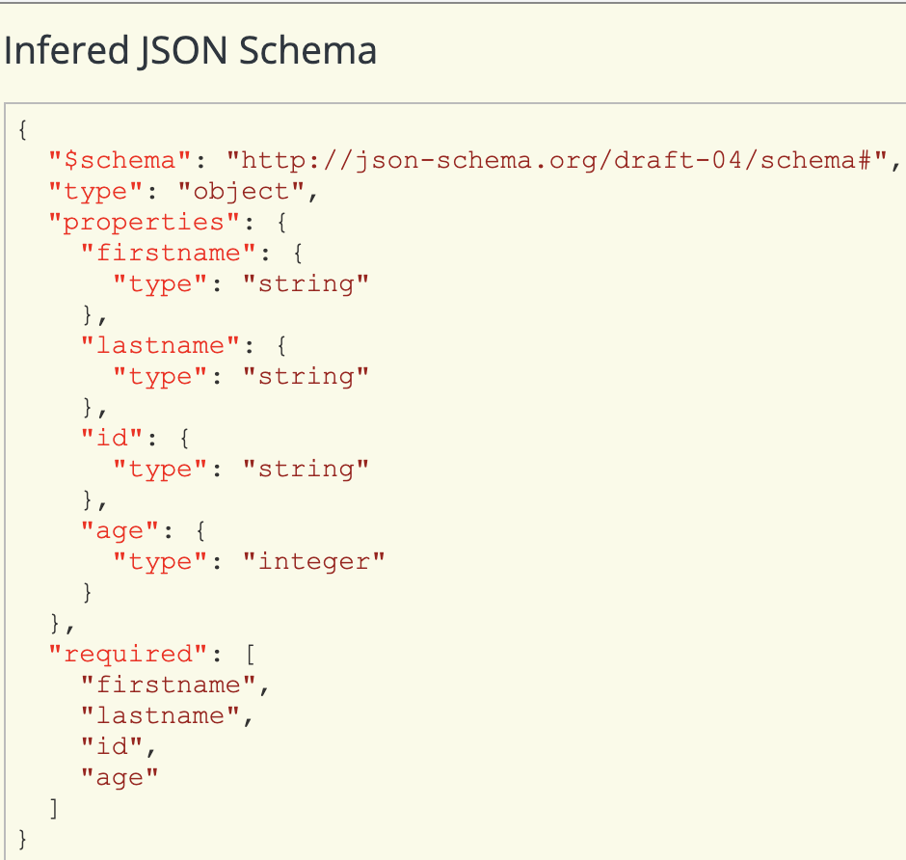
Schema Validation
What is JSON Schema:
JSON Schema is a specification for JSON based format for defining the structure of JSON data.
Json schema is json representation to describe another json.

Slide 3
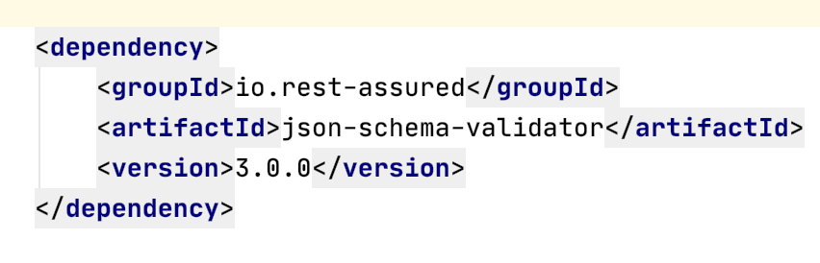
JSON to JSON schema
https://www.liquid-technologies.com/online-json-to-schema-converter
Json schema validator dependency

Slide 4
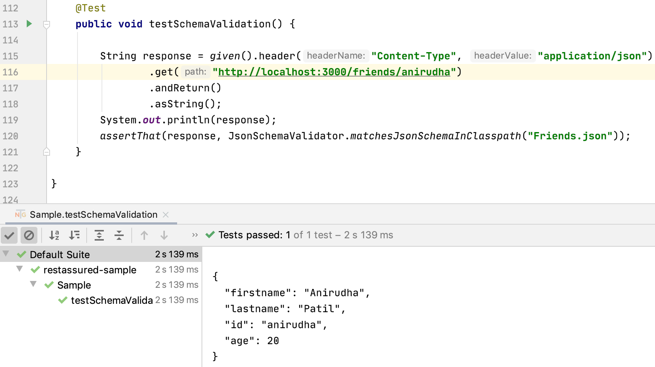
JSON schema validation example
Test
schema

Slide 5
API Automation strategies
CRUD Strategy
Verify with DB
Compare with static data
Mocking/Service Virtualization

Slide 6
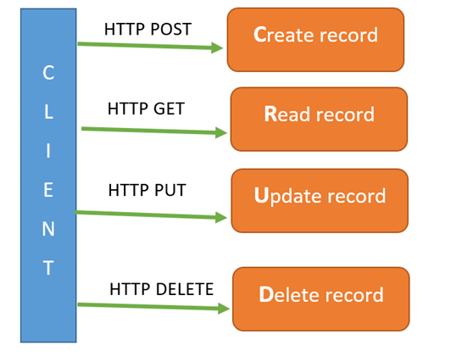
CRUD Strategy
Create Records
Read Records
Update Records
Delete Record

Slide 7
Verify with Database
Verify Response data with database.(by fetching data from database with the use of queries and stored procedures.)
Compare with static data
Verify Response data with static data (in JSON or XML etc.)

Slide 8
Mocking and Service Virtualization
A mock API server or mock server API imitates a real API server by providing realistic mock API responses to requests.
They can be on your local machine or the public Internet.
Responses can be static or dynamic, and simulate the data the real API would return, matching the schema with data types, objects, and arrays.

Slide 9


